Slide 1

CAMPUS RECOVERY SYSTEM
For College Campuses
Developed By: Viraj Naik
Academic Year: 2024–2025
Tech Stack: HTML/CSS/JS, Django/PHP, MySQL

Slide 2

Introduction: Addressing Campus Inconvenience
The Problem
Our Solution
Lost items on campus lead to significant inconvenience and frustration for students and faculty alike. The current methods for reporting and recovering items, primarily through notice boards or word-of-mouth, are highly inefficient and often ineffective.
We propose a digital platform designed specifically for reporting and tracking lost and found items. This web-based system aims to streamline the process, making it faster and more reliable.
Centralized digital repository.
Disruption to daily student life.
Enhanced communication between parties.
Lack of a centralized tracking system.
Cost-effective implementation (no IoT integration in initial phase).
Increased administrative burden.

Slide 3




Core Objectives of the System
Our primary goals are to enhance efficiency and security in managing lost and found items on campus.
Centralized Reporting
Faster Communication
Provide a single, accessible platform for all lost and found item reports.
Enable quick and direct communication between item owners and finders.
Secure Record-Keeping
Reduce Manual Efforts
Maintain secure and verifiable digital records for administrative oversight.
Automate reporting and matching processes to minimize human intervention.

Slide 4

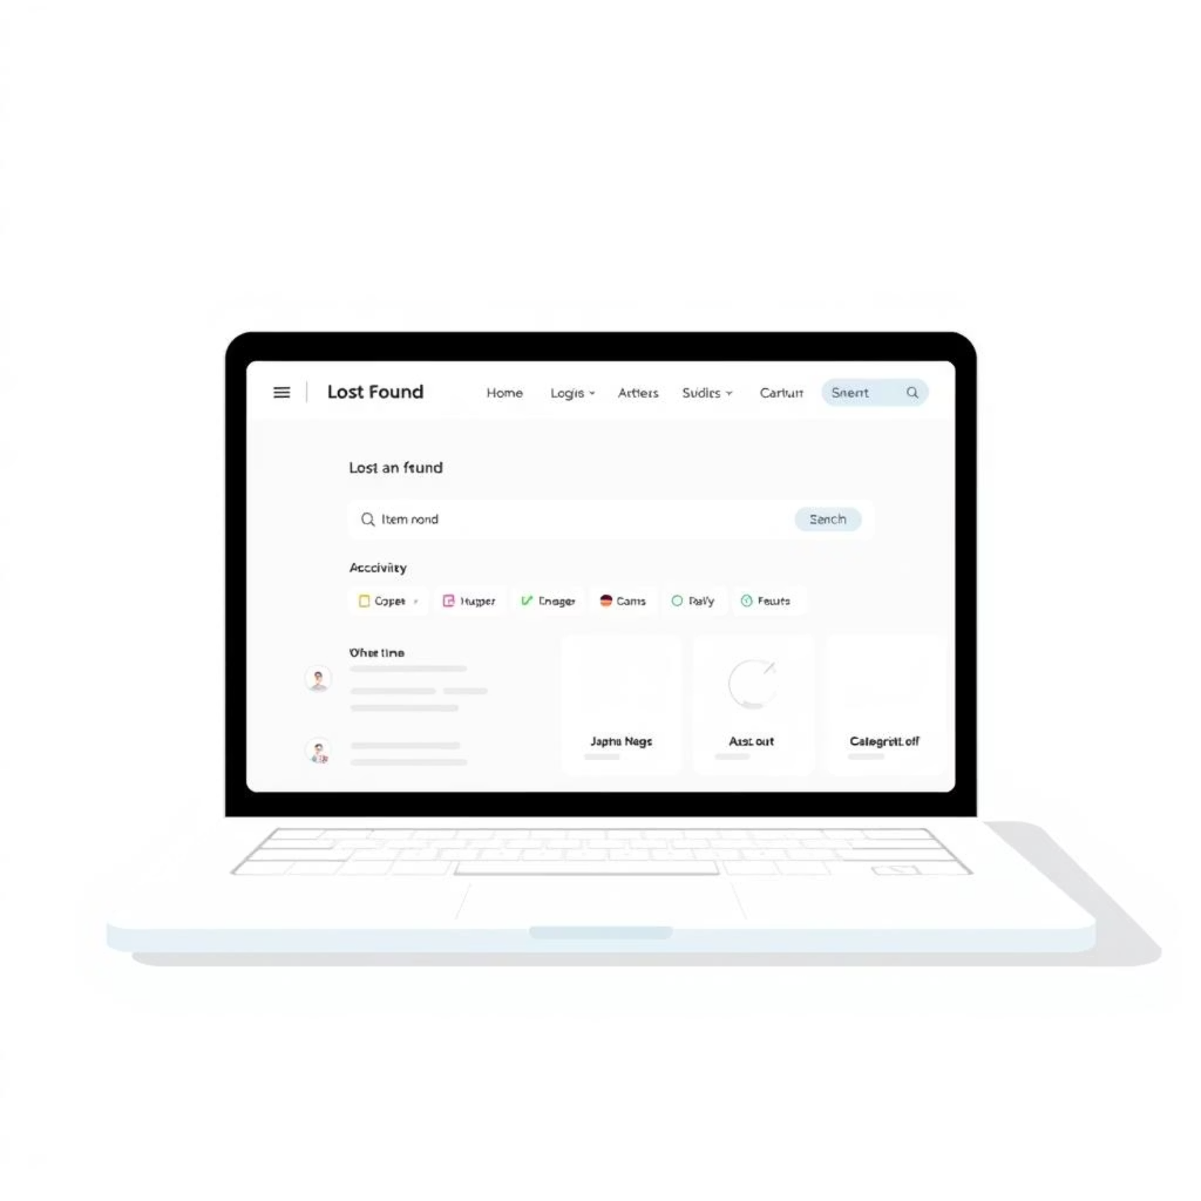
System Comparison: Old vs. New
Existing System: Inefficient & Fragmented
Proposed System: Modern & Streamlined
Manual Notices: Reliance on physical bulletin boards and verbal announcements.
Web-Based Platform: Centralized digital access for all users.
No Tracking History: Lost items are rarely recorded, leading to dead ends.
Database-Backed Records: Comprehensive, searchable history of all reports.
Slow Resolution: Identification and return processes are protracted and disorganized.
Real-Time Matching: Instant search and potential matches for lost and found items.
Limited Reach: Information spread is confined to physical locations.
24/7 Accessibility: Users can report and search anytime, anywhere with internet access.

Slide 5
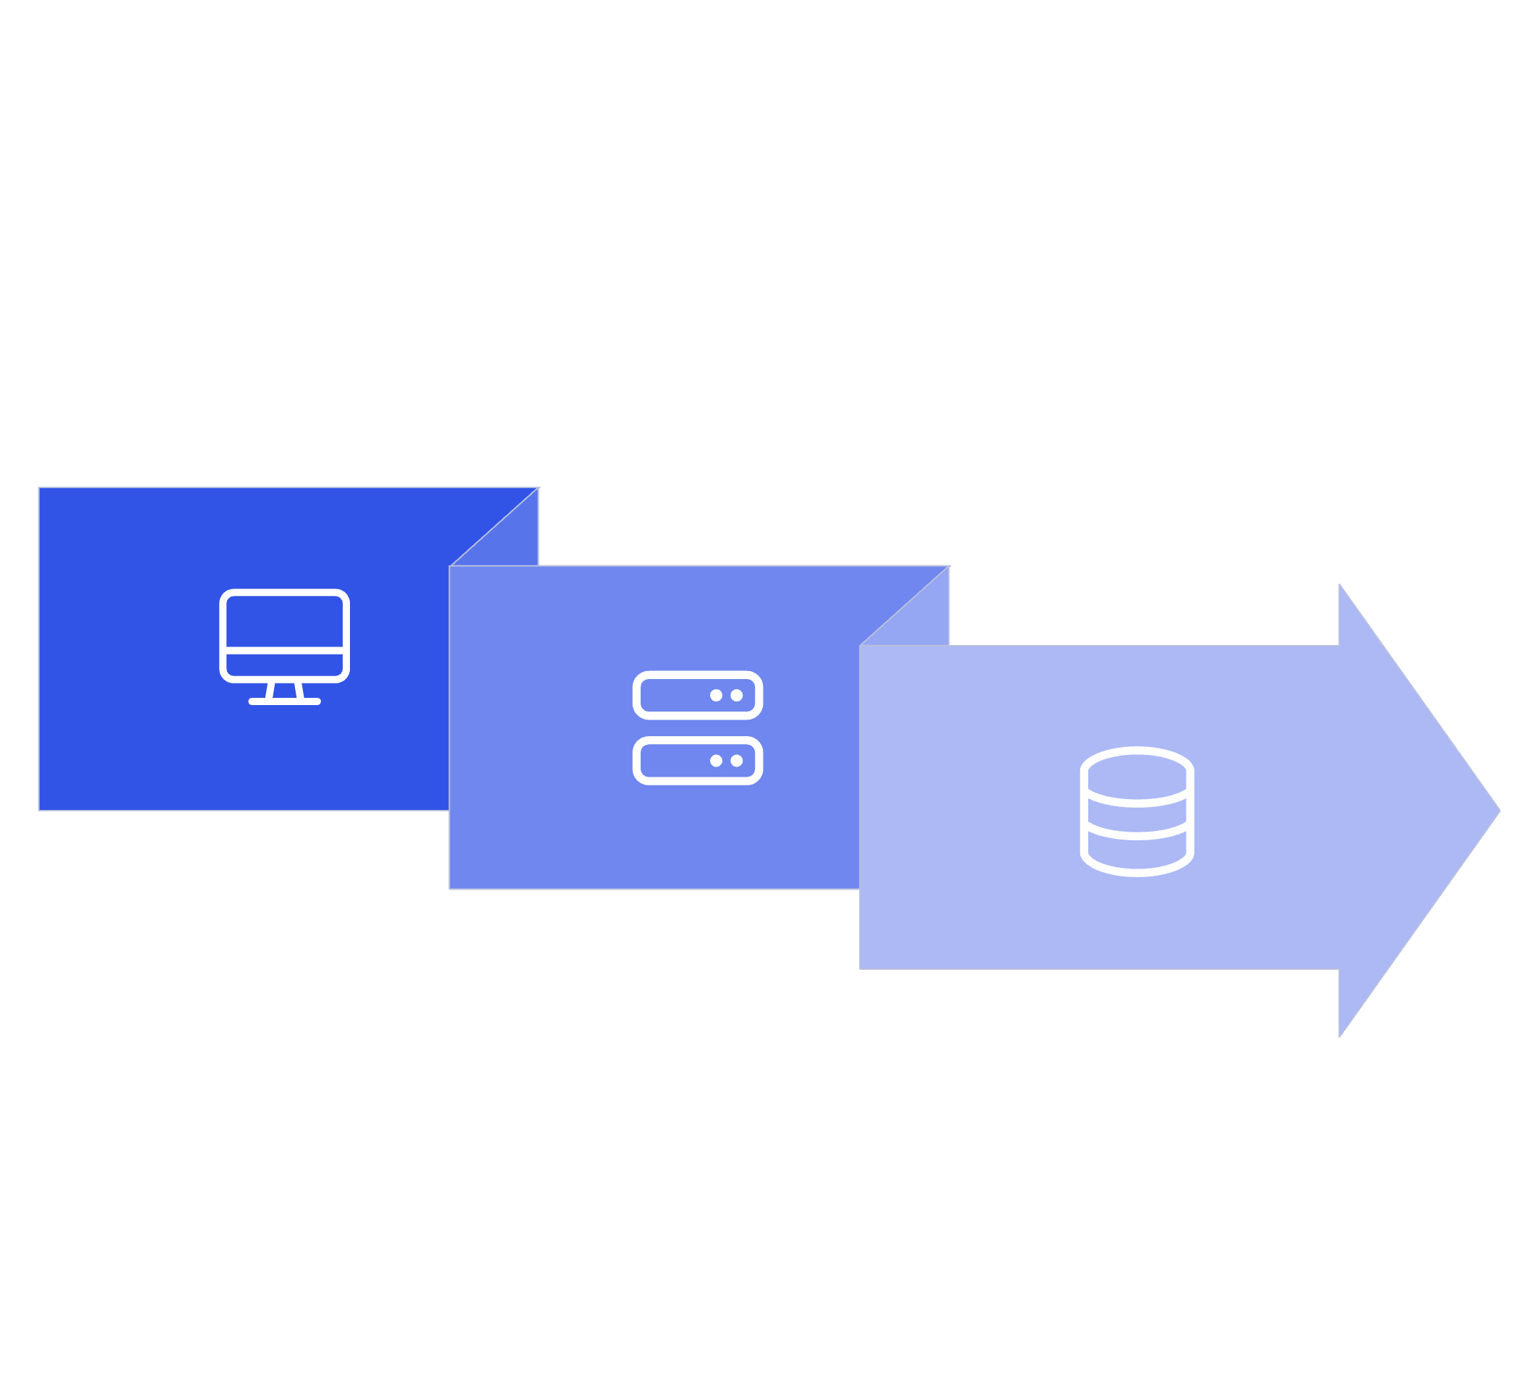



System Architecture: A 3-Tier Approach
Our system leverages a robust 3-tier architecture to ensure scalability, maintainability, and efficient data flow.
Frontend
Database
Backend
Frontend (User Interface)
Backend (Logic & Authentication)
Database (Data Storage)
Developed using HTML, CSS, and JavaScript. This layer handles the user experience, allowing for seamless interaction with the platform. It's designed to be intuitive and responsive.
Powered by Django or PHP, this layer manages all the business logic, user authentication, and communication with the database. It ensures data integrity and security.
Utilizing MySQL, this tier securely stores all user information, lost item details, and found item records. It is optimized for quick retrieval and reliable storage.

Slide 6
Key Functional Modules
The system is divided into several core modules, each addressing a specific aspect of the lost and found process.
1
User Authentication
Secure login and registration process for all users, ensuring data privacy and accountability.
2
Lost Item Report
A user-friendly form for reporting lost items, including detailed descriptions and optional photo uploads.
3
Found Item Report
A similar interface for reporting found items, capturing essential details for matching.
4
Admin Panel
A dedicated interface for administrators to verify, manage, and track all reported items.
5
Search & Matching
An advanced search function that automatically suggests potential matches between lost and found items based on keywords and categories.

Slide 7
Database Design: Core Tables
The relational database schema is designed to efficiently store and retrieve all necessary information for the Lost Item Report System. We use MySQL for robust data management.
users
user_id
name, email, password (hashed)
lost_items
item_id
description, date_lost, photo_url, user_id (FK)
found_items
item_id
description, date_found, photo_url, user_id (FK)

Slide 8
Key Advantages of Our System
Our digital platform offers significant improvements over traditional methods.
⚡ Faster Reporting & Resolution
📁 Digital & Centralized Records
Users can report items instantly from anywhere, accelerating the matching process and reducing wait times for owners.
All data is stored digitally, eliminating paper clutter and creating a searchable, organized database for quick retrieval.
🔒 Secure User Authentication
💰 Cost-Effective Solution
Robust login and registration mechanisms ensure that personal information and item details are protected.
By focusing on a software-only approach without initial IoT hardware integration, we keep implementation costs minimal.

Slide 9


Limitations and Future Enhancements
Current Limitations
Future Enhancements
Internet Dependency: Requires an active internet connection for access and reporting.
Mobile Application: Develop native iOS and Android apps for enhanced accessibility and push notifications.
Manual Photo Matching: Currently, visual matching of items relies on manual review by users or administrators.
Image Recognition (AI): Integrate AI algorithms for automated visual matching of uploaded photos.
Limited Offline Capability: No functionality available without network access.
IoT Integration: Explore incorporating QR codes or RFID tags for automated item identification and tracking.
Automated Notifications: Implement email/SMS alerts for new matches or updates on reported items.

Slide 10

Conclusion & Q&A
Impact of the Missing Item Report System
This system offers a practical and effective solution to a common campus problem. By centralizing reporting, enhancing communication, and maintaining secure records, it significantly improves efficiency and reduces inconvenience.
Solves a real and persistent campus issue.
Scalable for adoption by other educational institutions.
Promotes a more organized and supportive campus environment.
Thank You!
We are now ready to answer your questions.

